Slide 1

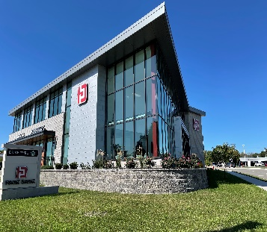
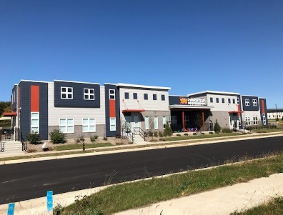


Committee of the Whole
Fitchburg
City Council
Orientation
April 23, 2025
Notes:
Good morning. Thank you for the opportunity to provide you with a Fitchburg development update. Existing business expansions, multi family apartment construction and new single family housing subdivisions are driving our local economy as we move forward in 2019.

Slide 2

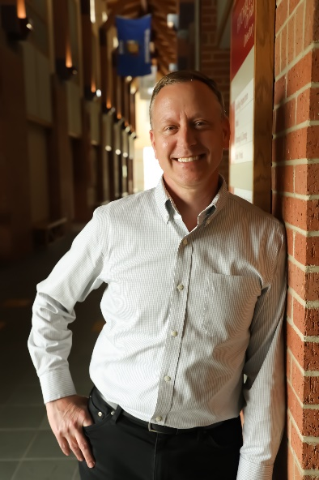

Chad Brecklin
City Administrator
Adam Sayre
Deputy City Administrator
Contact:
Chad.Brecklin@Fitchburgwi.gov
Phone: (608) 270-4208
Contact:
Adam.Sayre@Fitchburgwi.gov
Phone: (608) 270-4209
www.fitchburgwi.gov

Slide 3
Presentation Agenda
Department Overview and Staffing
Department Heads and Staff
Agenda Information
City Council Meetings and Resources
City Council Role
Alder Conduct
Committees, Commissions, and Boards
Questions

Slide 4
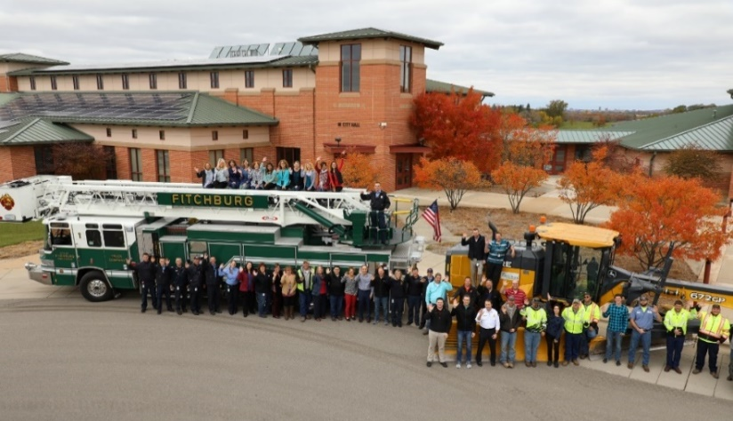
Department Overview and Staffing
Department | Staff
Administration | 3
Assessing | 5
Building Inspection | 4
Buildings/Grounds | 5
Clerk | 4
Economic Development | 3
FACTv | 3.5
Finance | 6.5
Fire | 19
Human Resources | 3
IT | 7
Legal | 1
Library | 15.5
Municipal Court | 1.5
Parks | 8
Planning | 5
Police | 67
Public Works | 25.5
Recreation | 2
Senior Center | 7
Total | 195.5

Slide 5
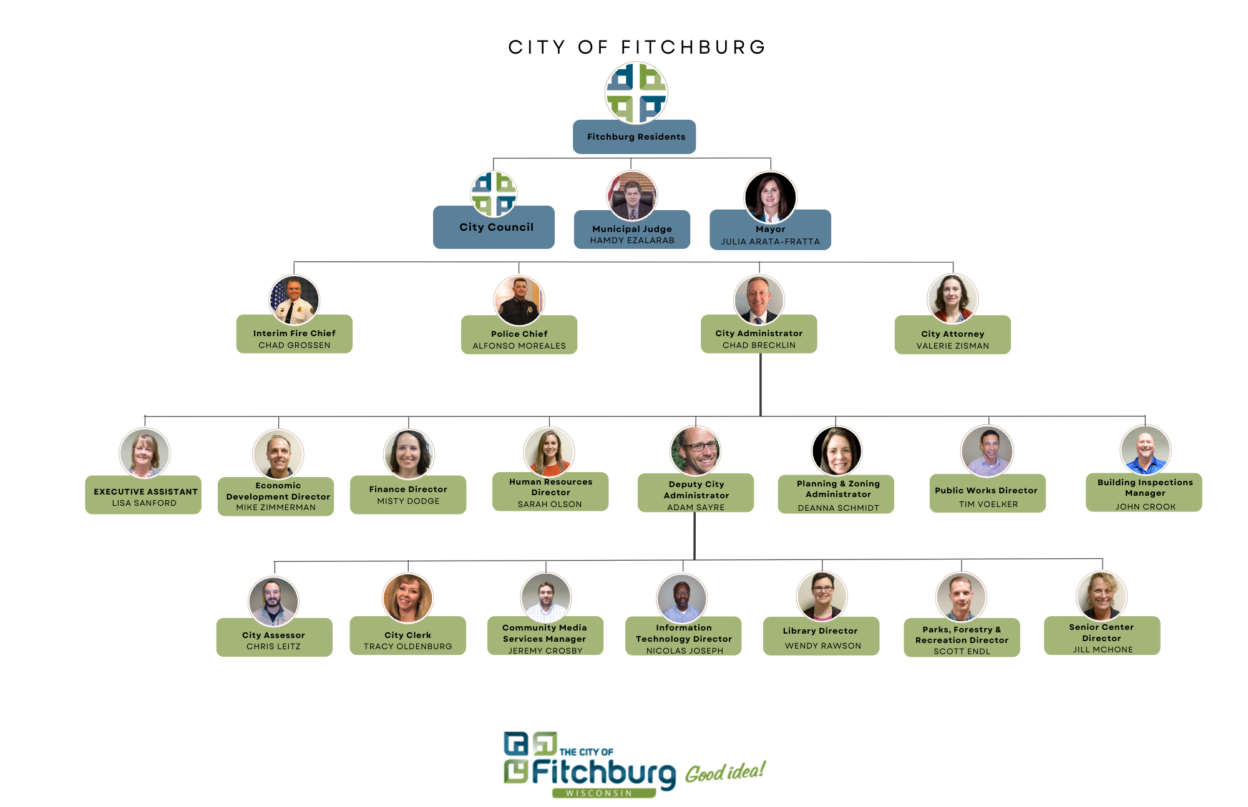
Organizational Structure

Slide 6
Department Overview and Staffing
Seventeen City Departments
Four Report to Mayor
Police
Fire
Legal
Administration
Six Report to City Administrator
Seven Report to Deputy City Administrator
Municipal Court Reports to Municipal Judge

Slide 7
Department Overview and Staffing
Department Descriptions
Employee Handbook (pages 11 – 13)
FitchRona EMS District (Cities of Fitchburg and Verona and Town of Verona)
Multi-Jurisdiction Public Safety Information Systems (MPSIS) – Fitchburg, Sun Prairie, Middleton, Monona, and Verona

Slide 8
Department Heads and Staff
Trained and Experienced Professionals in their Field
Responsible for the Day-to-Day Operations
Encouraged to Contact Department Heads
Learn About Department Operations
Going Well / Areas of Improvement
Operational Considerations
Existing Process and Functions of the Department
Proposals for New Programs and Initiatives
Proposals for New Ordinances
Act/Recommend in the Best Interests of the City
Please Include Adam or I in Email Correspondence with City Staff

Slide 9
City Council Meetings
City Council Meetings
Second and Fourth Tuesday of the Month at 6:30 pm
Generally, the First Meeting in July and Second Meeting in December are Not Held
Committee of the Whole
Fourth Wednesday of the Month at 7:00 pm
Quorum of Common Council = 6 Alders
Please Notify Mayor, Council President, City Clerk, and/or City Administrator if You are Unable to Attend a Meeting or will be Late

Slide 10
Agenda Information
City Council Meeting Agenda and Packet is Posted to City Website on the Friday before the Meeting
Agenda Purpose
Provides Structure to Facilitate Efficient and Effective Use of Meeting Time
Satisfy the Subject Matter and Notice Requirements of Wisconsin’s Open Meetings Law
If a Subject is not on the Agenda, it Cannot be Lawfully Discussed or Acted Upon

Slide 11
Agenda Information
Agenda Packet
Contains Supplemental Information for Agenda Items
Referral Sheet – Brief Overview/Background of Agenda Item
Supporting Documents (Examples include Permit/License Applications, Development Plans, Contracts, Staff Memos, etc.)
Staff Recommendation
Resolution – The Direction Given/Action Taken
Please contact City Administrator or Department Head with Questions or Clarifications in Advance of Meeting to Allow Time to Gather Information
Adding an Item to the Agenda
Mayor
Two Alders
Formal Motion by Council
Agenda Items from Elected Officials due at 12 pm on Wednesday before the Meeting
Contact City Administrator and/or Department Head for Assistance, Questions, Perspective, etc.

Slide 12
Agenda Information
Consent Agenda
Routine Matters
Single Motion, Seconded, and Adopted by Majority Vote to Approve, Adopt, etc., All Matters on Consent Agenda
Alder May Request Removal of an Item on the Consent Agenda to be Separately Discussed and Acted Upon
Referrals and Direct Referrals
Majority of Agenda Items Referred for Action at Next Council Meeting
Some Agenda Items Direct Referred for Action at Current Council Meeting, Usually Due to Time-Sensitivity

Slide 13
Agenda Information
Public Comment on Non-Agenda Items
Members of the Public Can Provide Comments on Items Not on the Agenda
Comments Limited to Three Minutes; Also Applies to Committees and Commissions
No Discussion Should Occur with People Making Public Comment
If Council has an Interest to Discuss a Topic Further, the Topic Should be Added to a Future Agenda

Slide 14
City Council Resources
Alders Issued a City Email Account
Contact IT with Questions
Password Reset is Automated Using Office 365
Encouraged to Sign-up for Notifications
Agendas, News Releases, Project Info, Alerts, etc.
City Staff
Council Handbook
League of Wisconsin Municipalities Training
Council Resource Page
Committee-Commission Handbook
Capital Improvement Plan
Other Documents – City Attorney Orientation Presentation

Slide 15

City Website
15
Comprehensive Plan
Parks and Open Space Plan
Financial Records and Reports
Housing Reports
Healthy Neighborhoods Initiative
Tax Increment Districts (TID) & Plans
Anton Drive Planning Study, Southdale Neighborhood Plan
Organizational Charts, Organizational Review & Staffing Plan

Slide 16
City Government and Common Council
Chapter 4 of Fitchburg Ordinances
Form of Government – Sec. 4-1
Composition of City Council – Sec. 4-23
Rules – Sec. 4-24
Quorum – Sec. 4-26
Powers of the City Council – Sec. 4-33
Standing Committees – Sec. 4-97
Committee of the Whole
Finance
Personnel
Public Safety and Human Services

Slide 17
Committees, Commissions, and Boards
Chapter 6 of Fitchburg Ordinances
Most are Advisory to City Council and Do Not Have Authority to Pass Legislation, Set Policy, or Direct Staff
Staff Contact Assigned for Each
Encourage You to Speak with Staff Contact for the Committees, Commissions, and Boards you are a Member of for Information on Current Activities/Items
Recognize and Assess Whether Programs, Initiatives, and Ordinances May Have an Impact on City Operations and Finances, a Disparate Impact on Others, and Unintended Consequences if not Fully Vetted

Slide 18
Alder Role and Conduct
Your Individual Role Lies with Your Vote
Independently, You Lack Authority
Improper (and potentially illegal) to Unilaterally Order or Direct Staff to do Something You Want or to Represent the City’s Interest or Position When Not Authorized to do so
You Must Work Together with your Fellow Alders to Adopt Rules, Policies, Resolutions, Ordinances and Set Priorities at a Published and Accessible Public Meeting

Slide 19
Alder Role and Conduct
Your Responsibility is Significant
Decision-Making on Behalf of the Residents of the City
Decisions may Impact Community for Decades to Come
Compliance
Ethics Laws
Conflicts of Interest
Open Records Laws
Personal Emails, Text Messages and City Business
Open Meetings Laws
Negative Quorum – A Number of Members Less Than a Quorum that has Enough Members to Influence Decision-Making on Policy
Walking Quorum – Members Hold a Series of Gatherings Among Members, Whether in Groups or as Individuals, and Agree to Act Uniformly in Sufficient Numbers to Reach a Quorum

Slide 20
Alder Role and Conduct
Respect
Disagreement and Debate are Healthy Components of Democracy
Respect for Community Members, City Staff, One Another
Demeaning, Sarcastic, Telling Others How to do Something, and Other Unprofessional Behaviors are not Productive or Acceptable
Please Do Not Involve Staff in Politics
Impacts City’s Employee Recruitment and Retention Efforts
Treat Others as You Would Want to be Treated
Your Actions and Conduct Set the Tone for our Community and Organization

Slide 21
Closing and Questions
Ride-a-Longs with Police & Fire Departments
City Administrator, City Attorney, Department Heads Can Answer Questions, Provide Background and History
How the City Communicates
League of Wisconsin Municipalities Training for Elected Officials
Supplemental Materials from League of Wisconsin Municipalities
Pocket Guides on State Ethics Code and Open Meetings Law
“So You’ve Been Elected…”
I, Along with All City Staff, Look Forward to Working with You as we Serve our Community!
Questions

